Slide 1
classdef AdniDemographics < handle
%% queries "all_FDG_20211123_12_14_2021.csv"
% 14358 imaging items, all DCM, acquired 09/22/2005 - 10/13/2021
% 1660 unique subjects, acquisition ages 55 - 96 years, 924 males, 736 females
% 303 unique subjects progressed to AD
% visit numbers 2 - 101
% groups: {'AD', 'CN', 'EMCI', 'LMCI', 'MCI', 'SMC'}, SMC ~ significant memory concern
% group scans: { 551 949 534 249 1341 111}
%
% 3444 'Co-registered Dynamic'
% 3444 'Co-registered, Averaged'
% 3735 'Coreg, Avg, Standardized Image and Voxel Size'
% 3735 'Coreg, Avg, Std Img and Vox Siz, Uniform Resolution'
%
% ImageDataID Subject Group Sex Age Visit Modality Description Type AcqDate Format Downloaded
% ____________ ______________ ______ _____ ___ _____ ________ _______________________________________________________ _____________ __________ _______ __________
%
% {'I1480670'} {'941_S_6962'} {'AD'} {'F'} 75 2 {'PET'} {'Coreg, Avg, Standardized Image and Voxel Size' } {'Processed'} 08/10/2021 {'DCM'} 11/23/2021
% {'I1480672'} {'941_S_6962'} {'AD'} {'F'} 75 2 {'PET'} {'Co-registered, Averaged' } {'Processed'} 08/10/2021 {'DCM'} 11/23/2021
% {'I1480671'} {'941_S_6962'} {'AD'} {'F'} 75 2 {'PET'} {'Coreg, Avg, Std Img and Vox Siz, Uniform Resolution'} {'Processed'} 08/10/2021 {'DCM'} 11/23/2021
% {'I1480673'} {'941_S_6962'} {'AD'} {'F'} 75 2 {'PET'} {'Co-registered Dynamic' } {'Processed'} 08/10/2021 {'DCM'} 11/23/2021
% {'I1301874'} {'941_S_6854'} {'AD'} {'M'} 86 2 {'PET'} {'Coreg, Avg, Std Img and Vox Siz, Uniform Resolution'} {'Processed'} 02/24/2020 {'DCM'} 11/23/2021
% ...

Slide 2
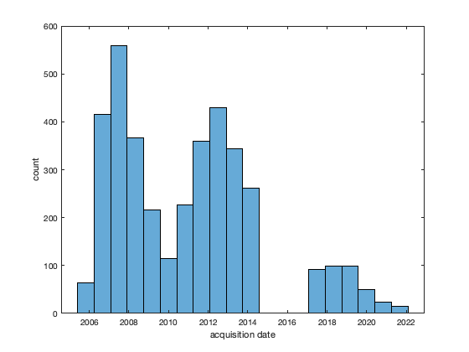

Slide 3
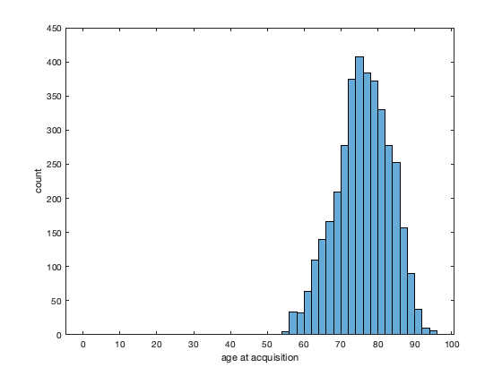

Slide 4
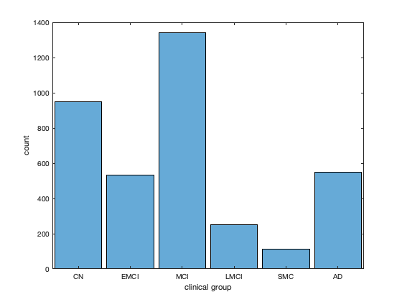

Slide 5
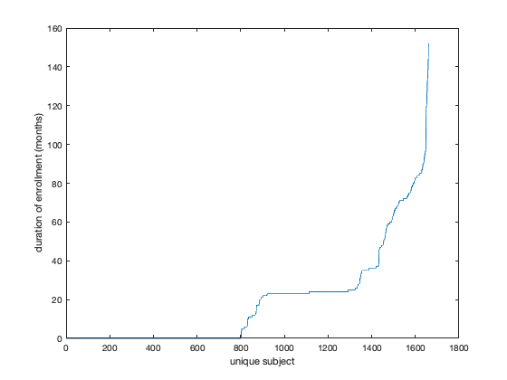

Slide 6
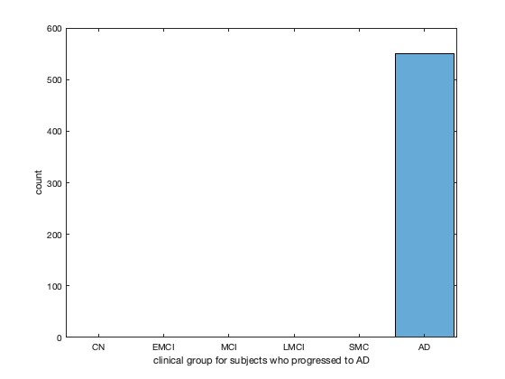

Slide 7
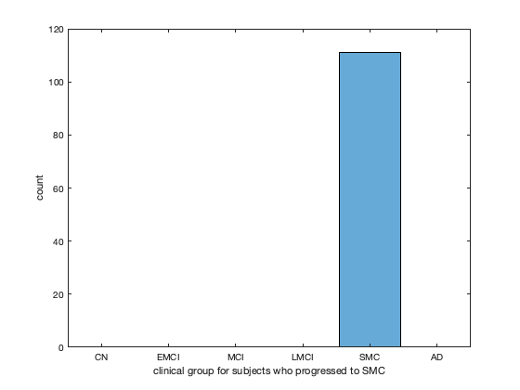

Slide 8
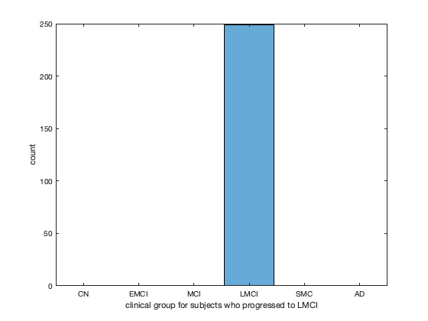

Slide 9
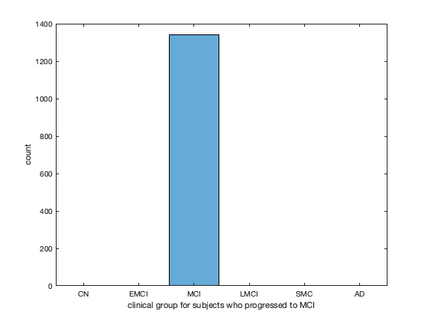

Slide 10
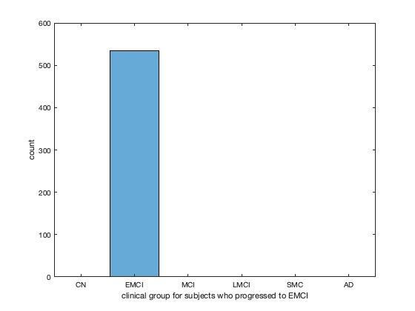

Slide 11
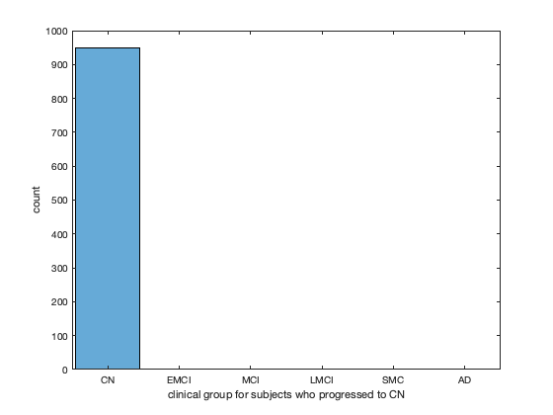

Slide 12
Next steps
Adnimerge
Tadpole challenge + adni; google group

Slide 13
